Slide 1
Investing in Maine’s future
TechStart Grant & Seed Grant Workshop
October 2017

Slide 2
MTI Mission:
Diversify and grow Maine’s economy by encouraging, promoting, stimulating, and supporting innovation and its transformation into new products, services and companies, leading to the creation and retention of quality jobs in Maine.

Slide 3
MTI continued:
Is Maine’s leading tool for investing in and developing innovative technology companies that bring new opportunity and wealth to Maine
Offers early-stage patient capital for the R&D of technologies
Was authorized in 1999 by the Maine Legislature
Is a 501 ©3 non-profit organization governed by a Governor appointed, industry-led Board of Directors
Annual appropriate of around $7 million
Has managed over $100 million in voter-approved R&D bonds on behalf of the State of Maine

Slide 4
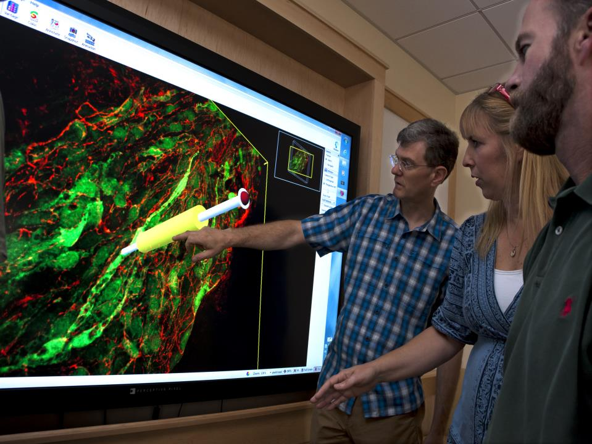
Since 2000
$200 million invested
$900 million leveraged

Slide 5
Fiscal year 2017
MTI invested over $7.07 million in 156 innovative projects across Maine through its suite of funding programs.
Program | Awards | Total
TechStart Grant | 37 | $168,821
Seed Grant | 55 | $1,211,906
Dev Loans / Equity | 10 | $3,056,536
Accelerator Grants | 13 | $283,283
Phase 0 | 14 | $65,840
Cluster Initiative | 8 | $2,107,123
Other | 19 | $176,825

Slide 6
Life cycle of a venture or product:
Where MTI works.
TechStart
Seed Grant
Development Loan
Equity Capital
SBIR/STTR Federal R&D Funding

Slide 7
Requirements
Applicant must be a Maine organization or have a core footprint in Maine at the time of investment
Potential for strong economic impact
Compelling innovation
Minimum 1:1 Matching funds

Slide 8
Our $uite of Opportunities
Developing your innovation
Tech Start Grants
Seed Grants
Development Loans
Growing your business
Accelerator Grants
Equity Capital Investments
Supporting the ecosystem
Cluster Initiative Program
Maine Technology Asset Fund 2.0
Bringing R&D $ to Maine
SBIR/Federal R&D Funding
Technical Assistance Program
Phase 0 Grant

Slide 9
Tech Start Grants: up to $5,000
Intended for small projects that lay basic business groundwork for future technology-based development;
Market Research
Business Plan Development
IP Filings
Offered monthly
Limited to 6-month projects
Can receive two within a 12-month period

Slide 10
Seed Grants: up to $25,000
Intended for early-stage, specific R&D projects
Prototype development and beta testing
Detailed market evaluation
Lay groundwork for securing additional capital leading toward commercialization
Offered 3x per year
Projects limited to 12-month duration
Limits: Organization or Principal Investor
Can receive two Seed Grants (up to $50,000) for one technology
Can receive two Seed Grants (up to $50,000) in a 24-month period

Slide 11
Development Loans: $30,000 to $500,000
Similar to Seed Grants, but allowing for larger more comprehensive projects
Proof of Concept, Prototype Development
Alpha Tests, Product Development Iterations, Beta Tests
Design for Manufacturing , Scale-up of Manufacturing with limited production
Limited costs for sales & marketing, overhead/indirect
Offered on a rolling basis.
Repayment terms and security interest may vary by applicant (goal is low cost)

Slide 12
Accelerator Grants: up to $50,000
To support commercialization and business development capacity-building activities that are required to advance a new technology to market
Up to $15,000 (Phase I) and $50,000 (DL and Phase II)
Business plan/model development
Commercialization planning
ID customers, strategic partners
Marketing strategy & research
Fundraising for partners/investors
1:1 match required for Dev Loan projects. No additional match required for SBIR/Fed Funded Projects

Slide 13
Equity Capital: up to $200,000
Offered on a rolling basis
Available only to MTI (SG & DL) & advanced SBIR/STTR awardees
“Tops-off” or augments existing round on same terms
1:1 co-investment required, 3 to 1 preferred in the round
Supports attracting initial early-stage outside investment necessary for growth
Typically preferred shares and/or convertible debt

Slide 14
Cluster Initiative Program:
Planning, Feasibility, Demonstration, or Pilot Projects: up to $50,000 rolling basis
Implementation Projects: up to $500,000 on a rolling basis
Private sector-led strong partnerships
Build on knowledge-based and value-added advantages
Innovation can occur in a variety of ways: products, services, and business models
Money is important but networks are more important
Measure success/impact throughout

Slide 15
Maine Technology Asset Fund 2.0:
An investment in Research, Development and Commercialization
Program Authority
“An Act to Authorize a General Fund Bond Issue to Stimulate Investment in Innovation by Maine Businesses to Produce Nationally and Globally Competitive Products and Services” – LD1053, Public Law Chapter 479
$45 million invested
Infrastructure, equipment and technology upgrades
Gain & Hold Market Share, Increase Revenues, JOBS

Slide 16
Federal SBIR/STTR Program
Small Business Innovative Research/Small Business Technology Transfer
A $2.5B+ early stage R&D funding resource for early-stage, high-risk innovative technology leading to commercialization – currently for small businesses only, with some exceptions.
Eleven Federal Agencies participate – issuing solicitations requesting innovative proposals meeting Agency topics of interest
Three Phase Program
Phase I – Feasibility: up to $150K in 6 month period of performance
Phase II – Prototype Development: up to $1M – two year period of performance
Phase III – Commercialization: no SBIR/STTR funding

Slide 17
The MTI Process
Creation
Evaluation & Approval
Action
Next Step?
Review with MTI Staff
Idea
Identify possible matching $
MTI staff works to coach
Screening Committee
Considerations:
Market Analysis
Technical Merit
Commercialization
Economic benefit to Maine
Evaluated by domain experts
Approved & Funded
Venture implements the project as defined by their Scope of Work
Meet regularly with MTI Staff
Submit project reports
Grow
Project may move to next funding stage
Move to commercialize product
Move to scale venture
Become sustainable enterprise

Slide 18
How does MTI help?
Connections to Advice, Counsel and Mentors;
E-Residence Program - Experienced team of entrepreneurs, business executives and subject matter experts made available to the firms as mentors and advisors to meet specific business challenges and opportunities
SBIR/STTR Funding Experts
Portfolio Exposure to Equity Firms
Commercialization, Technology Transfer, Marketing
Commitment to Venture Success;
The MTI brand

Slide 19
Examples of MTI’s Network
Entrepreneur and Network Support Organizations | R&D Institutions | Economic Development & Trade Organizations | Investment
Maine Accelerates Growth Maine’s Technology Incubation Centers Foster Innovation Center at UMaine Association for Consulting Expertise (ACE) SCORE Maine Small Business Administration (SBA) Small Business Development Centers (SBDC) Maine Center for Entrepreneurial Development (MCED) | The Jackson Laboratory Bigelow Laboratory for Ocean Sciences Gulf of Maine Research Institute (GMRI) Downeast Institute University of Maine System University of New England | Maine Department of Economic and Community Development Maine & Company Maine International Trade Center (MITC) Manufacturers Association of Maine (MAME) Manufacturing Extension Partnership (MEP) Maine Aerospace Alliance Maine Composite Alliance E2Tech Bioscience Association of Maine | Maine Venture Fund (SEGF) Coastal Enterprises (CEI) Finance Authority of Maine (FAME) Maine Angels Network Bangor Angels Slow Money Maine No Small Potatoes (for farms, fisheries and food businesses)

Slide 20
Impact & Evaluation
As part of the State’s biennial review of its economic investments, an independent consulting firm evaluated MTI and presented its findings in January 2016. The report concluded that MTI . . .
“Is the focal point of Maine’s R&D efforts”
“Encourages growth in an active, hands-on, collaborative way”
“Is true to its mission and mandate”
“Development Loan effectively improves innovation, economic development, and the R&D environment while also providing a positive return on investment” for Maine.

Slide 21
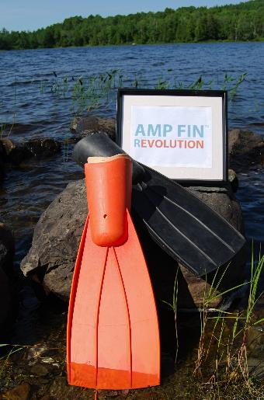
AMP FIN, LLC
A revolutionary patent pending swim fin has been designed and developed for adult leg amputees. Amp Fins™, LLC is now ready to begin R & D for children’s custom fit fins. This will require a formal prototype of said product, as well as research of best type of production and material composition. Once production details are confirmed and prototype completed, product testing will begin for this segment of the population. (Seed Grant)

Slide 22
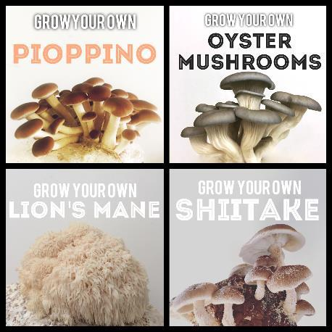
North Spore Mushroom Company is developing new technologies for specialty mushroom production utilizing a hardwood substrate and cold pasteurization technique that is more cost effective than traditional methods of mushroom cultivation. By increasing our spawn production capacity, constructing a clean room for inoculation, and further developing substrate formulations we will be able to commercialize this technology, improve its efficiency, and extend it into a wider diversity of mushroom species. (2 Seed Grants)

Slide 23
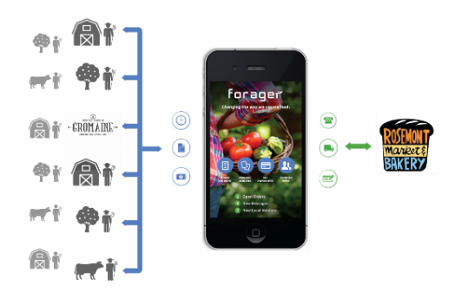
The demand for locally sourced food is growing, with the market in excess of $7 billion and steadily increasing.
Forager will build a mobile software platform that automates the order to payment process for locally purchased foods and will leverage that platform to launch an online marketplace where local producers can offer their products for sale for retail buyers. (TechStart Grant, 2 Seed Grants, Development Loan, Accelerator Grant)

Slide 24
Mingle Analytics, LLC is an early-stage business that provides information technology services to healthcare providers, enabling accurate and efficient reporting of quality data to Medicare’s
Physician Quality Reporting System (PQRS).
Based in South Paris, Maine, Mingle Analytics has grown to 50 employees including many highly-skilled IT professionals. Mingle Analytics’ early-stage success has created tech and healthcare-related jobs in Oxford County, and MTI Development Loan funding will allow the company to accommodate significant growth objectives. ( 2 TS, SG, 2 DL, AG)

Slide 25
Our Team…
President
Brian Whitney
bwhitney@mainetechnology.org
Director, Business Development
Joe Migliaccio
jmigliaccio@mainetechnology.org
Director, Finance & Administration
Greg Lee
glee@mainetechnology.org
Scott Bursey
sbursey@mainetechnology.org
Director, Investment Operations
Director, Innovation Infrastructure
mbentley@mainetechnology.org
Martha Bentley
psutter@mainetechnology.org
Web Communications Mgr.
Patti Sutter
Investment Officers
sbeckim@mainetechnology.org
Shane Beckim
lsimms@mainetechnology.org
Lou Simms
bjones@mainetechnology.org
Brian Jones
kdoughty@mainetechnology.org
Loan and Grant Associates
Kim Doughty
afinkenhoefer@mainetechnology.org
April Finkenhoefer

Slide 26
Seed Grant
Developing a minimum viable product to see if it works, if someone will buy it, and how much they will pay for it.

Slide 27
Seed Grants: up to $25,000
Intended for early-stage, specific R&D projects:
Prototype development and beta testing
Detailed market evaluation
Lay groundwork for securing additional capital leading toward commercialization
Offered 3x per year
Projects limited to 12-month duration
Limits: Organization or Principal Investor
Can receive two Seed Grants (up to $50,000) for one technology
Can receive two Seed Grants (up to $50,000) in a 24-month period

Slide 28
Seed Grant funds are only eligible for specific activities
Eligible activities
Ineligible activities
Proof of Concept
Prototype Development
Prototype Testing
Field Trials and Pilot Studies
Activities included in the TechStart Grant if they are part of a proposed broader technology R&D project
Additional market research
IP protection
Sales and marketing activities (different from market research)
Overhead or indirect costs
Any expenditures before the submission date for the round

Slide 29
Steps for submitting a Seed Grant application
Download application instructions
Concept Review Meeting
Prepare & submit application
Access application instructions on MTI website
Review criteria that must be addressed within the application
Begin process of seeing how your project aligns with the scope of the application
Schedule early in process is better in order to give time to iterate on application if needed
Be sure that the project is a fit to the Seed Grant and MTI purpose
Incorporate any feedback from concept review meeting
Leverage resources, like Maine Small Business Development Centers to review and provide feedback
Paper copy or electronic (all in one PDF) submissions accepted

Slide 30
Components of the Seed Grant Application
History of prior funding: MTI or other
Feedback for Resubmission
Narrative Component – 5 pages
Scientific and Technical Merit
Market Potential
Scope of Work
Commercialization Strategy
Maine Economic Impact
Management Team
Supporting Documents – 4 pages
Budget
Budget Supporting Documents
Commitment Letters
Professional Summaries

Slide 31
1. History
In 2 pages or less, discuss the history you (and/or your company) have with MTI.
Briefly describe the scope of work and results of those projects
Discuss whether they led to successful commercialization and what was learned through those efforts
Discuss any outside funding you’ve received to help you get to this point

Slide 32
2. Feedback for Resubmission
In a single page, applicants who are resubmitting an application are encouraged to address the feedback from the prior application.
For Seed Grant Applications, the unfunded applicant is provided written feedback and is encouraged to contact MTI to discuss the review of their application in more detail with the goal of addressing the feedback in an improved resubmission.

Slide 33
3. Narrative – 5 pages
Introduction
You may begin the narrative with a brief introduction of the company, it’s history and mission.
It is helpful to include details such as existing revenues and employees.
Tip: If information was provided in the History section, do not duplicate it here.

Slide 34
3. Narrative – continued
Scientific and Technical Merit
What is it and what makes it unique?
This section should clearly describe the technology being proposed and what makes it meaningfully unique.
How does it work?
Clearly describe how the technology works and refer to diagrams/pictures in the supporting documents if needed.
Why is it important?
It should identify the problem that is being solved. Comparing the product, process or service to existing ones is ideal.
Tip: Pictures/diagrams often provide more clarification than words.

Slide 35
3. Narrative – continued
Market Potential – Very important!
Why pursue this technology?
It is expected that applicants will have some knowledge of the market opportunity and competition or would have conducted some basic secondary market research .
What is the opportunity?
Numbers and any relevant data should be used to support market estimates.
Who is the competition?
A comparative analysis is expected, particularly when the product being developed has significant, well-known competition.
Tip: Be sure to Google your company and technology, reviewers are likely to perform this task as well.

Slide 36
3. Narrative – continued
Scope of Work – Very important!
What are you going to do?
The experimental design of the R&D process is critical to the funding decision. It is important to describe in detail the study to be completed what specific objectives will be achieved.
Planning an experiment properly is very important in order to ensure that the right type of data and a sufficient sample size are available to answer the research questions of interest as clearly and efficiently as possible.
Who will do the work?
How will you determine if you’ve succeeded?
Tip: Get a Commitment Letter if using a consultant.

Slide 37
Experimental Design
Define objectives
What do you hope to accomplish?
Build it
What materials and equipment will be used?
What software/hardware is required?
Who is performing the tasks?
Test it
Who will conduct the testing?
What tests will they complete?
How many times and what set of parameters will be used?
Measure it
How will you define success/failure?
What are the key performance metrics?
Define objectives
Test it
Build it
Measure it

Slide 38
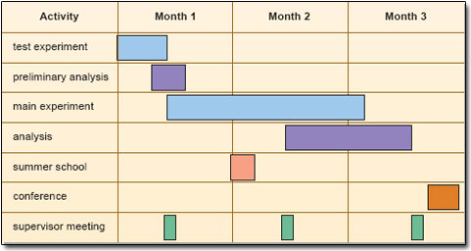
Gantt Chart

Slide 39
3. Narrative – continued
Commercialization Strategy - Based on a solid Business Plan
Identify and discuss the goals of the company:
What is the plan to start/grow your company?
If manufacturing is needed, who will perform this or who will you partner with?
If you plan to license the technology, to whom?
How does this project move you closer to commercialization or follow on investment opportunities?
What’s next for development and funding?
Tip: Strongly recommend that much of this section is pulled from a solid business plan.

Slide 40
3. Narrative – continued
Economic Impact (to Maine)
Discuss how this will ultimately lead to the creation or growth of the business
Discuss the types and number of jobs that could be created. What are the short term and long term needs of the company to achieve commercial success?
Provide revenue projections based on a solid business plan
Discuss the impact that this will make to the Maine economy and industry as a whole
Tip: Provide numbers, but be realistic!

Slide 41
3. Narrative – continued
Management Team (and partners)
Provide names and titles of those working on the project
Discuss what partners you are working with
Identify any mentors or advisors that are supporting the company
Do not delve into the resume details, leave that for the professional summaries section
Tip: Don’t do it alone. Maine has a lot of resources here to help you!

Slide 42
4. Supporting Documents
These should be used to augment the narrative
Four pages that may include:
Market Analysis & Comparative Analysis – Important!
Gantt Chart detailing project tasks and who is performing them
Support letter from partners / (potential) customers
Picture/diagram that explains the technology
Tip: Images can explain a lot. Use if necessary.

Slide 43
5. Budget
Only project expenses
Meet 1:1 match
Refer to Match Requirements and Allowable Rates Document
Tip: Use Budget Supporting Document

Slide 44
6. Commitment Letters
Up to two pages each
Identify where the matching commitment will come from for the project
Each consultant should provide a letter discussing their commitment and role on the project. You may use this to provide a detailed quote from a consultant or partner.
Tip: This is a good way to provide additional detail for the scope of work from the consultants.

Slide 45
7. Professional Summaries
Up to one page each
For each person listed on the project, including consultants
May include for advisors/partners as well
Find the experts!
Tip: Recommend using paragraph style and focus each one on how they fit to this project/technology.

Slide 46
Submit Seed Grant Application Online
Applications must be consolidated into a single PDF file then uploaded through the following portal:
https://www.GrantRequest.com/SID_2050?SA=SNA&FID=35038
Information you will be asked to provide:
General business info – name, phone, email, years in business, sector
Non-confidential summary – <100 words describing project
Identify and potential conflicted parties/reviewers
Tip: Don’t wait until 5 pm on the deadline day as there may be traffic!

Slide 47
Review Process for Seed Grant Applications
All complete applications are reviewed by the TBRC comprised of Tech Board Members from the selected sector
A recommendation is made to the MTI Board of Directors from each TBRC
Awardees may be required to meet with MTI, have 90 days to execute the contract and be paid 80% in advance
Non-awardees will be notified and provided with written feedback

Slide 48
Even More Tips!
Identify how MTI funds will add value to the proposed project.
Clearly articulate what the technology is and how it works and test it out on someone who is not so close to the project.
Identify what makes your technology better than current solutions by utilizing comparisons to existing technologies. Is it better or cheaper?
Identify what’s next and how this project gets you there.
A strong team will include employees, advisors, partners, vendors, clients and anyone else helping to bring this technology to market. Identify them!
Treat MTI like any potential investor. Make your pitch!
Re-read your application. Check for typos and math.

