Slide 1
TechStart Grant and Seed Grant Webinar Presenter: Shane Beckim sbeckim@mainetechnology.org 207-588-1018
8 Venture Avenue
Brunswick Landing
Brunswick, Maine 04011
207.582.4790
info@mainetechnology.org

Slide 2
What MTI Does:
We fund Maine entrepreneurs and companies who engage technology to develop innovative products and connect them to resources to help them grow profitable enterprises.

Slide 3
Funding Support through MTI’s Business Innovation Program
Stage of Project/Product Development
Corp/LLC & business plan creation
Proof of concept and prototype testing
Commercialization
Scale and Grow
MTI Seed Grant
MTI Development Loan
MTI Equity Capital**
Primarily business support
Primarily R&D support
(up to $25K)
(up to $250K or $500K)
($50-200K)
MTI Business
Accelerator Grant
(up to 10% of Dev. Loan value)
MTI TechStart Grant
Companion grants
(up to $5K)
MTI Business Accelerator Grant
(up to 20% or $15K Phase I Award or 10%/$50K Phase II Award)
RFA Coming Soon
SBIR/STTR Phase I*
SBIR/STTR Phase II*
MTI Equity Capital**
MTI Phase 0 KickStarter
(up to $5K)
($100-150K)
($1-1.5MM)
($50-200K)

Slide 4
MTI’s Business Innovation Program funds technology projects for Maine companies
Who is eligible to apply for funding?
Maine-based companies of any size
Registered to do business in state of Maine
Have definitive plans to create and/or retain Maine jobs
Companies with significant base of operations in Maine
Includes companies with clear plan to locate in Maine if not in state already
Maine-based academic & research laboratories
Must have expectation that technology will be further developed and/or commercialized via transfer into the marketplace

Slide 5
MTI’s Business Innovation Program funds technology projects for Maine companies
What key criteria must an eligible project meet?
Supports one of seven targeted technology sectors:
Biotechnology Composites & Advanced Materials
Environmental Technologies Forest Products & Agriculture
Information Technology Marine Technology & Aquaculture
Precision Manufacturing
Shows high potential for significant economic development to Maine, including:
Job creation and retention
Increased revenues and competitiveness
Company growth

Slide 6
MTI uses a rigorous, competitive evaluation process when reviewing applications
Evaluation Process
Applicants are strongly encouraged to talk with MTI staff prior to submitting a project for funding
Projects are selected for funding using a thorough evaluation process, which includes:
Evaluating the project’s technical merit
Considering the likelihood that the project will commercialize or increase existing sales.
Assessing the economic benefit to Maine
MTI is adding value to the company’s objectives

Slide 7
The TechStart Grant, a component of MTI’s Business Innovation Program
TECHSTART GRANTS PROVIDE UP TO $5,000 FOR BUSINESS PLANNING ACTIVITIES
Purpose of TechStart Grant:
To provide quick funding for specific small projects that will lay the basic business groundwork critical to securing additional funding
GRANTS FUNDED MONTHLY
UPCOMING KEY DATES:
Application Submission: December 1, 2015
Grant Notification by: December 22, 2015
Future Submissions: January 5 and February 2
For more information, contact:
Shane Beckim
sbeckim@mainetechnology.org
207-588-1018

Slide 8
Limitations and restrictions of the TechStart Grant
TechStart Grant funds may NOT be used as cash match to other MTI funding components
An organization or principal investigator may NOT exceed two TechStart Grants within a 12 month period
TechStart Grant projects must NOT be more than 6 months in duration
TECHSTART GRANTS REQUIRE AT LEAST 1:1 MATCH FROM THE APPLICANT

Slide 9
TechStart Grant funds are only eligible for specific activities
Examples of eligible activities
Examples of ineligible activities
Market analysis including surveys, interviews, purchase of data, activities related to quantifying the market opportunity
Business plan development including activities related to developing go to market strategies
Intellectual property investigation and filings
Planning and preparation activities in advance of future R&D activities
Expenditures for any R&D activities
Any expenditures before the submission date for the round
Overhead or indirect costs
Sales and marketing activities

Slide 10
Steps for submitting a TechStart Grant application
Download Application Instructions
Understand what the funder wants.
Concept Review Meeting
Be sure that the project is a fit to the TechStart Grant and MTI purpose.
Prepare application for submission
Address all criteria, get feedback
Create a rough draft of the scope of the project
Share your project draft with MTI
Follow the instructions

Slide 11
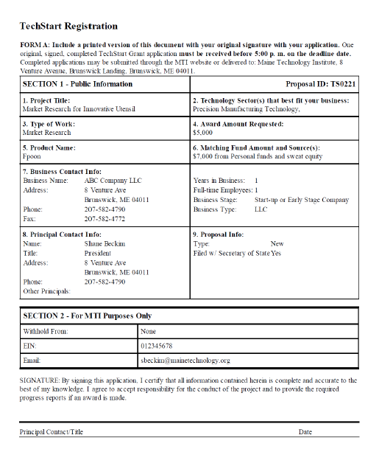
Components of the TechStart Grant Application
Form A Registration Form
This is the cover page to the application. The applicant must create an account at www.mainetechnology.org and fill out a registration form. Each application must have a unique application number which is generated from the registration.

Slide 12
Components of the TechStart Grant Application
Non-confidential Summary
Example
On this single page, this is an opportunity to get the reader’s attention and interest into what your application is about to propose. Be clear and concise and be sure to summarize the type of work and what the product is in 100 words or less.
Furnace sees an opportunity to launch a cold water equipment and apparel brand with the goal of becoming the world’s leader in wetsuit innovation. Our first product is the Response Dry Glove. The gloves are game changing for cold water athletes including surfers, stand-up paddle boarders, kite boarders, sailors and whitewater kayakers. They outperform and outlast traditional neoprene gloves in addition to being less harmful to the environment. Project success includes a business plan that communicates the full scope of our opportunity, customer validation, a Seed Grant proposal, incorporation and a partnership agreement.

Slide 13
Components of the TechStart Grant Application
History
Resubmission: Feedback
In 2 pages or less, discuss the history you (and/or your company) have with MTI. Discuss how those projects fared and what impact they have had on your company. Discuss whether they led to successful commercialization and what was learned through those efforts.
In a single page, applicants who are resubmitting an application are encouraged to address the feedback from the prior application. For TechStart Applications, there is no written feedback and unfunded applicants are encouraged to contact MTI to discuss the review of their application.

Slide 14
Components of the TechStart Grant Application
Narrative: 3 page limit to discuss the following criteria
Introduction
Scientific & Technical Merit
Before getting into the narrative, you may consider introducing your company to the reviewers and summarizing your intent of this project. This should not duplicate the NCS, but it should lay the setting for the stage of the company and development. This should show your commitment and passion and leave the reviewers feeling that what comes next is a well-defined plan.
This section should clearly describe the technology being proposed, what makes it unique and why anyone would be interested in it. It should identify the problem that is being solved. Comparing the product, process or service to existing ones is ideal. Describe how the technology is better or cheaper. Include an appropriately sized picture if possible.

Slide 15
Components of the TechStart Grant Application
Market Potential
Scope of Work
Although some TechStart projects are proposing to conduct market research, there must be a basis for why the applicant is pursuing the development of the technology in the first place. This section should discuss the market opportunity that this technology development will pursue. Numbers and any relevant data should be provided to support market estimates.
This section should clearly describe what will occur over the course of the project, who will perform each specific task and how they will be completed. Many of the tasks involve market research and business plan preparation, but the proposal must clearly state the targeted objectives and contain specifics on the steps to achieve those results.

Slide 16
Components of the TechStart Grant Application
Commercialization Strategy
Economic Impact
This section should identify the strategy and assumptions about the business model that have been targeted as strategic goals of the company. If it’s a product, this section should identify whether the company wishes to become the manufacturer, distributor or licensor of the product and how. For process improvements, identify how and where the technology will be implemented.
Describe how the proposed project may lead to positive impact for the State of Maine including jobs, revenues, and intellectual property.
Management Team
Identify names and titles/roles each person plays in the project and as part of the company’s effort to bring the technology to market. Do not include biographical information in this section.

Slide 17
Components of the TechStart Grant Application
Other Application Documents and Forms
Supporting Documents – 2 pages Often include published market information, letters from experts in the field, partners, collaborators, suppliers or potential customers, or pictures and diagrams of the technology.
Budget Form B – Excel Document: Be sure the match is equal to or greater than the amount being requested from MTI. The application may also contain a one page Budget Supporting Document explaining items listed in the budget.
Commitment Letters – 2 pages each Identify where all matching funds and commitments to the project will come from. These may include letters from the applicant and any parties who are contributing to the success of the project. All match funds should be accounted for.
Professional Summaries – paragraph style identifying experience

Slide 18
Review and Grant Process for TechStart Grant Applications
All complete applications are reviewed by the TechStart Review Committee comprised of MTI Staff, Tech Board Member, and BOD Member
Awardees will be emailed agreement docs, have 60 days to execute the contract and be paid 80% in advance
Non-awardees will be notified and encouraged to contact MTI for verbal feedback before resubmitting

Slide 19
The Seed Grant, a component of MTI’s Business Innovation Program
SEED GRANTS PROVIDE UP TO $25,000 FOR EARLY STAGE R&D ACTIVITIES
Purpose of a Seed Grant:
To provide funding for specific research and development projects that will lead to commercialization or lay the groundwork critical to securing additional funding
GRANTS FUNDED 3 TIMES EACH YEAR
UPCOMING KEY DATES:
Application Submission: December 15, 2015
Grant Notification: February 15, 2016
Future Submissions: April and August
For more information, contact:
Shane Beckim
sbeckim@mainetechnology.org
207-588-1018

Slide 20
Limitations and restrictions of the Seed Grant
Seed Grant funds shall NOT exceed $50,000 per organization or principal investigator for any one technology
Seed Grant funds shall NOT exceed $50,000 per organization or principal investigator within a 24 month period
SEED GRANTS REQUIRE AT LEAST 1:1 MATCH FROM THE APPLICANT

Slide 21
Seed Grant funds are only eligible for specific activities
Examples of eligible activities
Examples of ineligible activities
Proof of Concept
Prototype Development
Prototype Testing
Field Trials and Pilot Studies
Technology Transfer Activities
Activities included in the TechStart Grant if they are part of a proposed broader technology R&D project
Expenditures for any sales and marketing activities
Overhead or indirect costs
Any expenditures before the submission date for the round

Slide 22
Steps for submitting a Seed Grant application
Download application instructions
Concept Review Meeting
Prepare & submit application
Access application instructions on MTI website
Review criteria that must be addressed within the application
Begin process of seeing how your project aligns with the scope of the application
Schedule early in process is better in order to give time to iterate on application if needed
Be sure that the project is a fit to the Seed Grant and MTI purpose
Incorporate any feedback from concept review meeting
Leverage resources, like Maine Small Business Development Centers to review and provide feedback
Paper copy or electronic (all in one PDF) submissions accepted

Slide 23
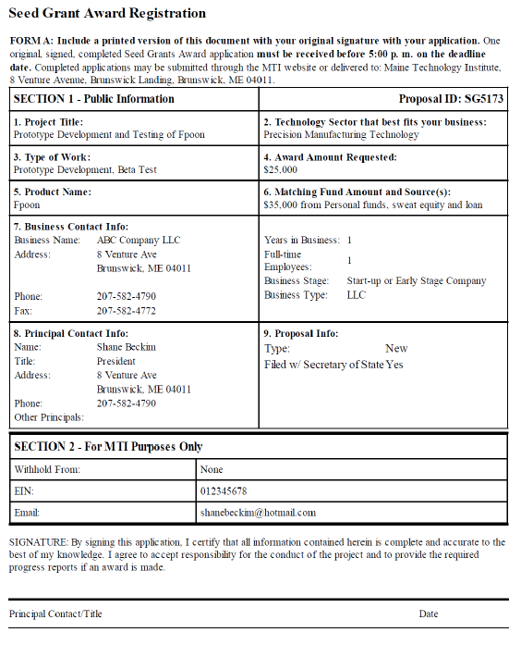
Components of the Seed Grant Application
Form A Registration Form
This is the cover page to the application. The applicant must create an account at www.mainetechnology.org and fill out a registration form. Each application must have a unique application number which is generated from the registration.

Slide 24
Components of the Seed Grant Application
Non-confidential Summary
Example
On this single page, this is an opportunity to get the reader’s attention and interest into what your application is about to propose. Be clear and concise and be sure to summarize the type of work and what the product is in 100 words or less.
An MTI Seed Grant will support the completion of HistoryIT’s web software ArchivesTree ™ version 1.0. This software will allow managers of historical collections to easily and efficiently organize, catalog, and share their collections. ArchivesTree™ fills a void, meeting technological and archival needs of cultural institutions facing limited software options. MTI’s support will allow ArchivesTree™ to complete development, and thus begin user testing and further product refinement. HistoryIT estimates that at least 100 customers will adopt ArchivesTree™ during 2013 and plans to grow the customer base of annual subscriptions each year, growing the company and its support services in Southern Maine.

Slide 25
Components of the Seed Grant Application
History
Resubmission: Feedback
In 2 pages or less, discuss the history you (and/or your company) have with MTI. Discuss how those projects fared and what impact they have had on your company. Discuss whether they led to successful commercialization and what was learned through those efforts.
In a single page, applicants who are resubmitting an application are encouraged to address the feedback from the prior application. For Seed Grant Applications, unfunded applicants are provided with some written general feedback and are encouraged to contact MTI to discuss the review of their application.

Slide 26
Components of the Seed Grant Application
Narrative: 5 page limit to discuss the following criteria
Introduction
Scientific & Technical Merit
Before getting into the narrative, you may consider introducing your company to the reviewers and summarizing your intent of this project. This section should identify the activities that have taken place to date and how your company is prepared to pursue the proposed project and subsequent commercialization efforts that will be required.
This section should clearly describe the technology being proposed, what makes it unique and why the market would be interested in it. It should identify the problem that is being solved. Comparing the product, process or service to existing solutions is necessary. Specific performance metrics including standards and specifications should be clearly identified.

Slide 27
Components of the Seed Grant Application
Market Potential
Scope of Work
More so than within the TechStart Grant, details about the market and competition are needed to justify the pursuit of the proposed technology. Market size data and trends along with the sources of that data are needed. A clear illustration of the competitive landscape is very important. This ties into the analysis of the competition in the Scientific and Technical Merit information.
This section should clearly describe what will occur over the course of the project, who will perform each specific task and how it will be completed. Identify specific details of the experimental design along with projected outcomes. Provide a time line or Gantt chart to better illustrate the tasks and those who will accomplish them.

Slide 28
Components of the Seed Grant Application
Commercialization Strategy
Economic Impact
This section should provide many elements of the company’s business plan including the sales and marketing strategy. Cost of production and targeted price points should be identified. First users and barriers to market entry should also be identified. If there is to be manufacturing, then the plans for doing so and the partners needed should be identified.
Describe how the proposed project may lead to positive impact for the State of Maine including jobs, revenues, and intellectual property. This section should identify the current number of jobs and sales the company has already achieved if applicable.
Management Team
Identify names and titles/roles each person plays in the project and as part of the company’s effort to bring the technology to market. Do not include biographical information in this section.

Slide 29
Components of the Seed Grant Application
Other Application Documents and Forms
Supporting Documents – 4 pages Often include published market information, letters from experts in the field, partners, collaborators, suppliers or potential customers, or pictures and diagrams of the technology.
Budget Form B – Excel Document: Be sure the match is equal to or greater than the amount being requested from MTI. The application may also contain up to 2 pages of Budget Supporting Documents explaining items listed in the budget.
Commitment Letters – 2 pages each Identify where all matching funds and commitments to the project will come from. These may include letters from the applicant and any parties who are contributing to the success of the project. All match funds should be accounted for.
Professional Summaries – paragraph style identifying experience

Slide 30
Review and Grant Process for Seed Grant Applications
All complete applications are reviewed by the TBRC comprised of Tech Board Members from the selected sector
A recommendation is made to the MTI Board of Directors from each TBRC
Awardees may be required to meet with MTI, have 90 days to execute the contract and be paid 80% in advance
Non-awardees will be notified and provided with written summary feedback

Slide 31
Tips
Identify how MTI funds will add value to the proposed project.
Clearly articulate what the technology is and how it works and test it out on someone who is not so close to the project.
Identify what makes your technology better than current solutions by utilizing comparisons to existing technologies…is it better or cheaper?
Be sure to detail the specific tasks and outcomes in the scope of work, particularly the experimental design.
Identify what’s next and how this project gets you there.
A strong team will include employees, advisors, partners, vendors, clients and anyone else helping to bring this technology to market…identify them.
Treat MTI like any potential investor…make your pitch!
Re-read your application…no typos and correct math.

Slide 32
Resources
Maine Center for Entrepreneurial Development www.mced.biz
Small Business Development Center www.mainesbdc.org
SCORE www.scoremaine.org
University of Maine Advanced Manufacturing Center john.belding@maine.edu Dept. of Industrial Cooperation kris.burton@maine.edu
Manufacturer’s Association of Maine www.mainemfg.com
SBIR/STTR – Karen West cpmgmt@fairpoint.net

Slide 33
www.mainetechnology.org
Shane Beckim
sbeckim@mainetechnology.org
207-588-1018

